Slide 1
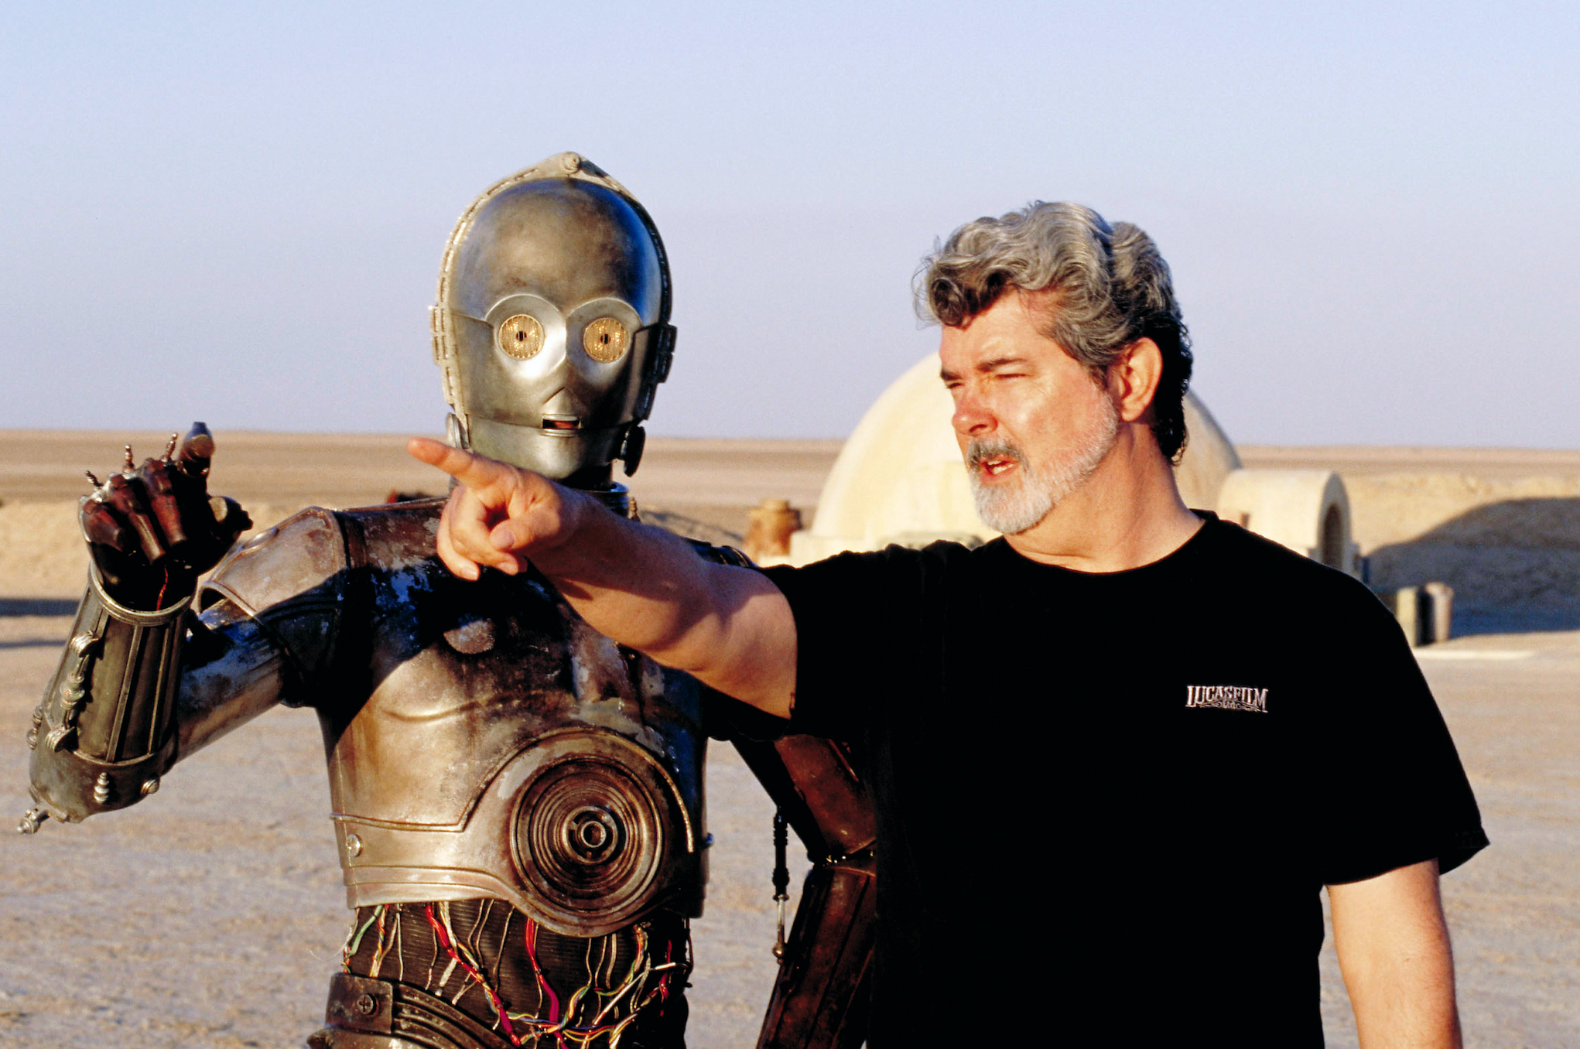
Cinematography Analysis
DSBA 5122
Manjinder Sandhu
Nizar Mamouni
Alex Brooks
Dagim Bantikassegn

Slide 2
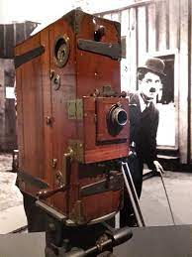
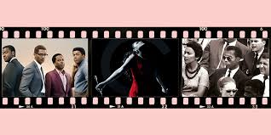
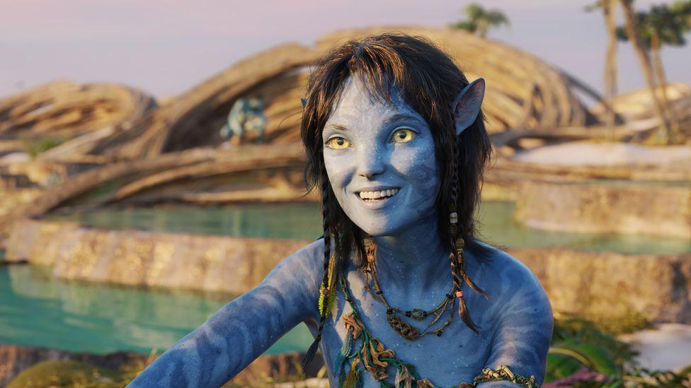
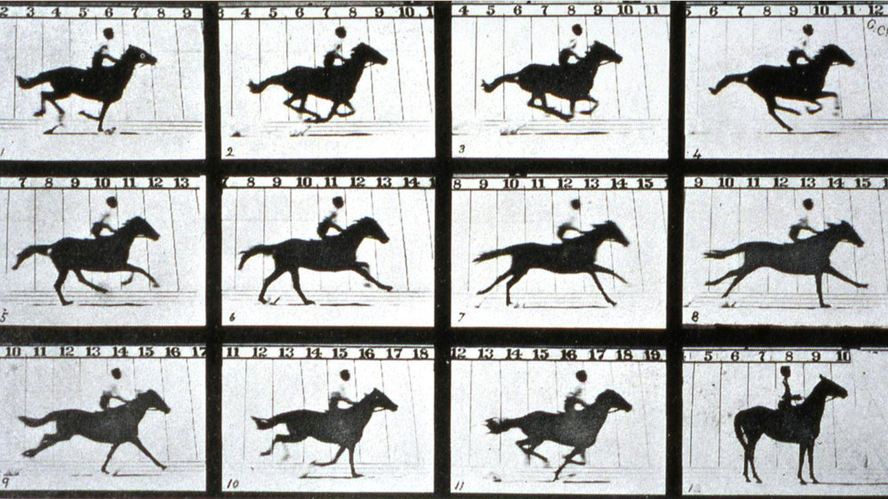
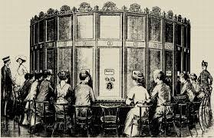


Notes:
Nizar: Lights, camera, action! Are you a film lover who wants to travel back in time and explore the evolution of cinema?
Dagim: Are you interested in learning about the different types of movies that have captured our imaginations over the years, and the legendary directors and actors who brought them to life?
Manjinder: Do you want to discover the secrets of success in the film industry, and how some of the greatest movies of all time have earned critical acclaim and commercial success
Manjinder: Join us as we embark on a journey through the history of cinema, from the silent era to the digital age, where we'll uncover fascinating insights into the movies that have shaped our world, the people behind them, and the business of entertainment that has made it all possible.
Nizar: So grab your popcorn and get ready for a cinematic experience like no other!

Slide 3
Introduction
How have different genres fallen and risen?
How has the movie industry grown?
Which genres, directors, actors, and actresses have won the most awards?
What are the differences within genres based on gender?
Dataset: https://www.kaggle.com/datasets/rishidamarla/films-dataset
Notes:
Nizar:Lights, camera, action! Are you a film lover who wants to travel back in time and explore the evolution of cinema?
Dagim: Are you interested in learning about the different types of movies that have captured our imaginations over the years, and the legendary directors and actors who brought them to life?
Manjinder: Do you want to discover the secrets of success in the film industry, and how some of the greatest movies of all time have earned critical acclaim and commercial success
Manjinder: Join us as we embark on a journey through the history of cinema, from the silent era to the digital age, where we'll uncover fascinating insights into the movies that have shaped our world, the people behind them, and the business of entertainment that has made it all possible.
Nizar:So grab your popcorn and get ready for a cinematic experience like no other!

Slide 4
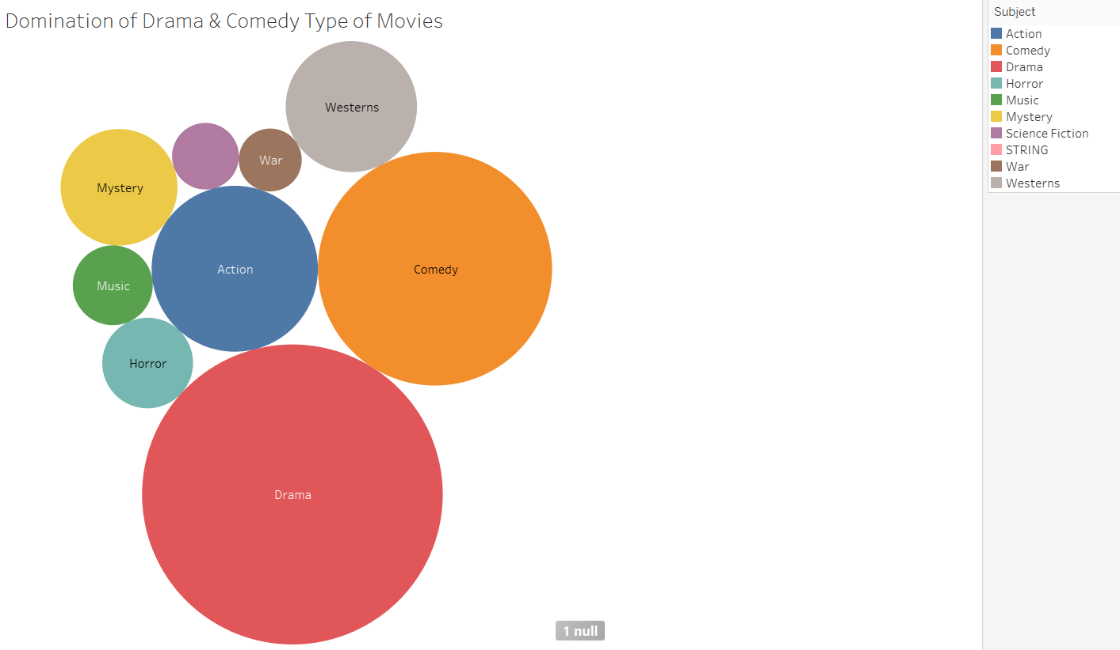
Domination of Drama & Comedy Type of Movies
Notes:
Manjinder
Discuss the colors and their meanings
We can see how Drama is the biggest circle
The second largest circle is Comedy
War and Science Fiction are very small compared to Drama and Comedy

Slide 5
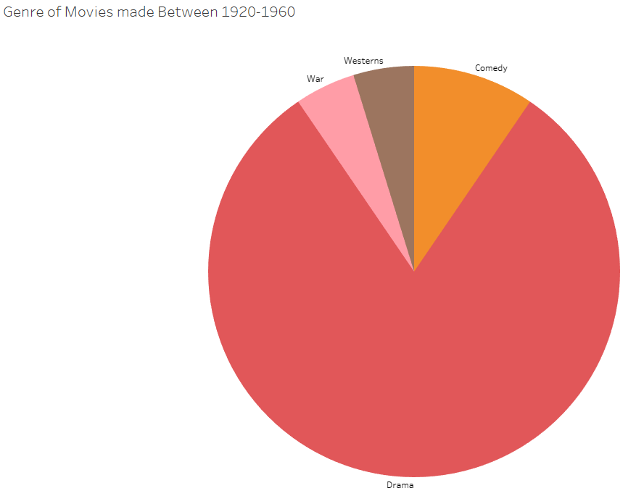
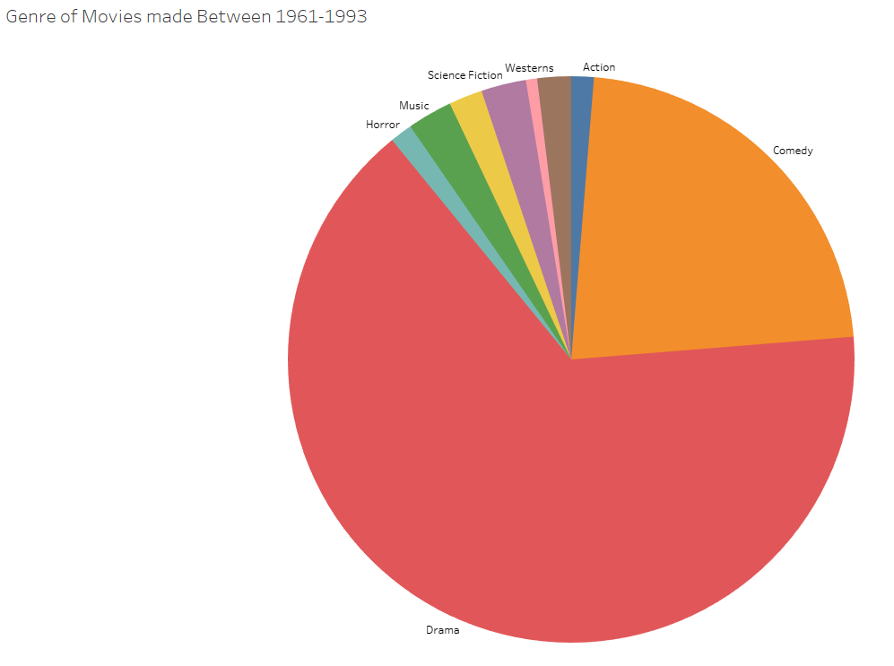
Change of Genre Over Time
Genre of Movies made Between 1920-1960
Genre of Movies made Between 1961-1993
Notes:
Manjinder
How Drama use to be the biggest around 80 to 85 percent
Then from 1961 to 1993 Comedy started to get bigger around 20 percent
From 1920 to 1960 there were only 4 genre
Now there are 9 genres
Western and War movies have decreased

Slide 6
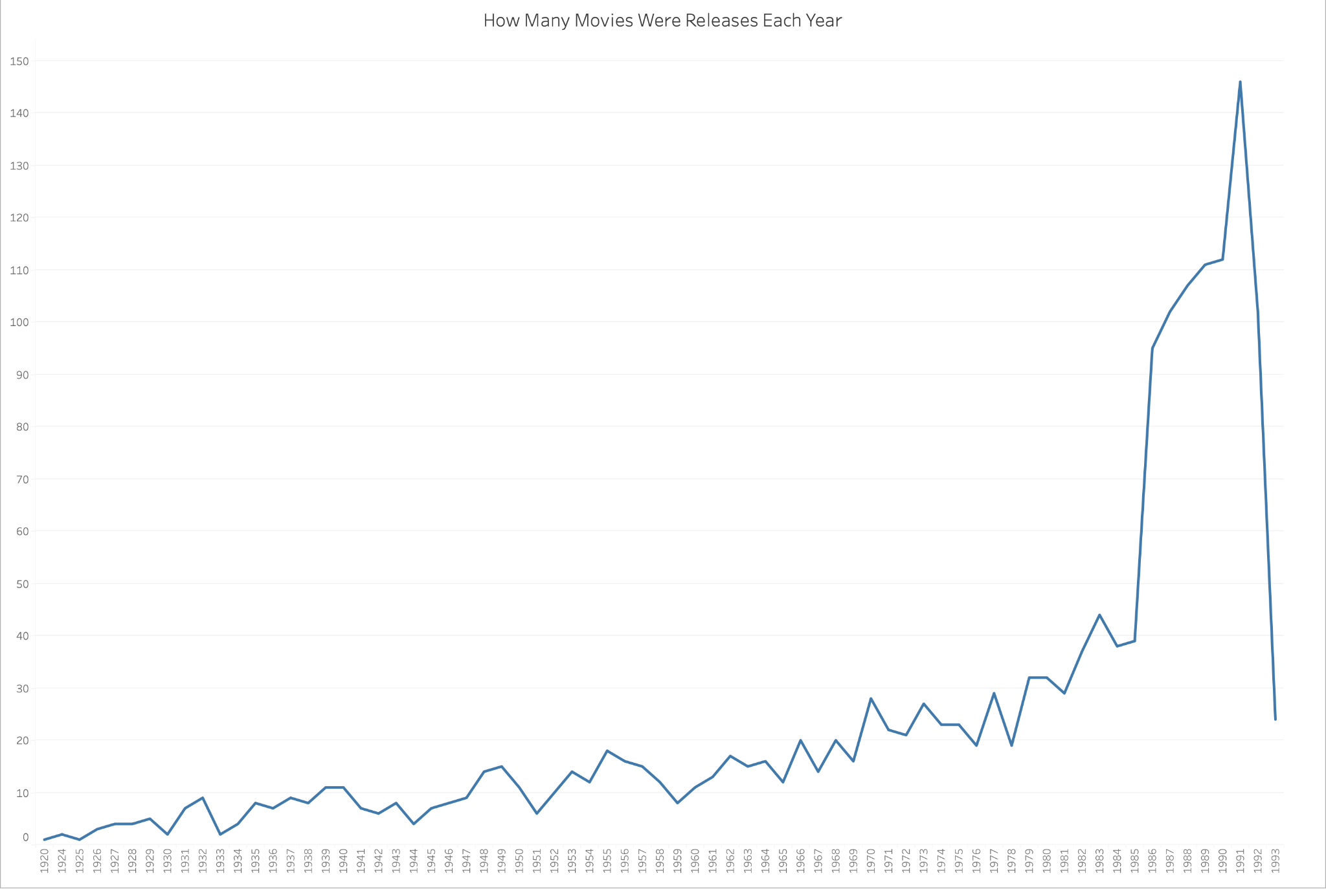
How many movies were released each year
Count (Title)
Notes:
Manjinder
Over time to new technologies movies started to get released
Some technology factors that made more movies get release are
1923: Introduction of Sound
Small Spike in 1932 due to the 3 color Techicolor
From 1985 to 1991 there were a huge spike in movies
That was due to CGI
That made making movies a little easier and more action could happen

Slide 7
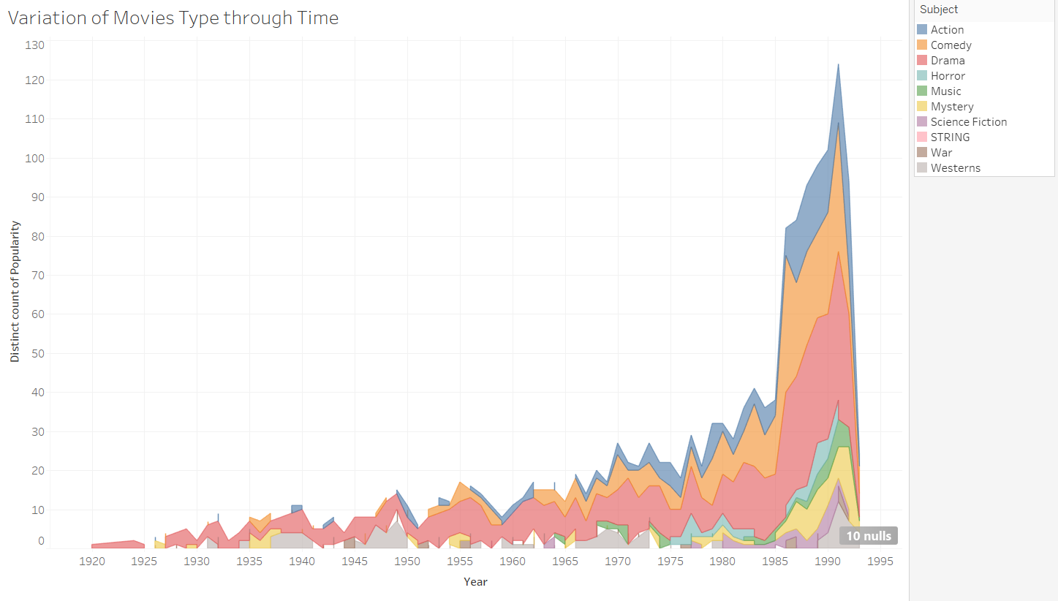
Popularity of Movies based on Genre
Notes:
Nizar
1-Dominance of drama era: 20- 50
2-shrinking of western movies past 70
3-Apparence of new movie type: music early 70, horror in 75

Slide 8
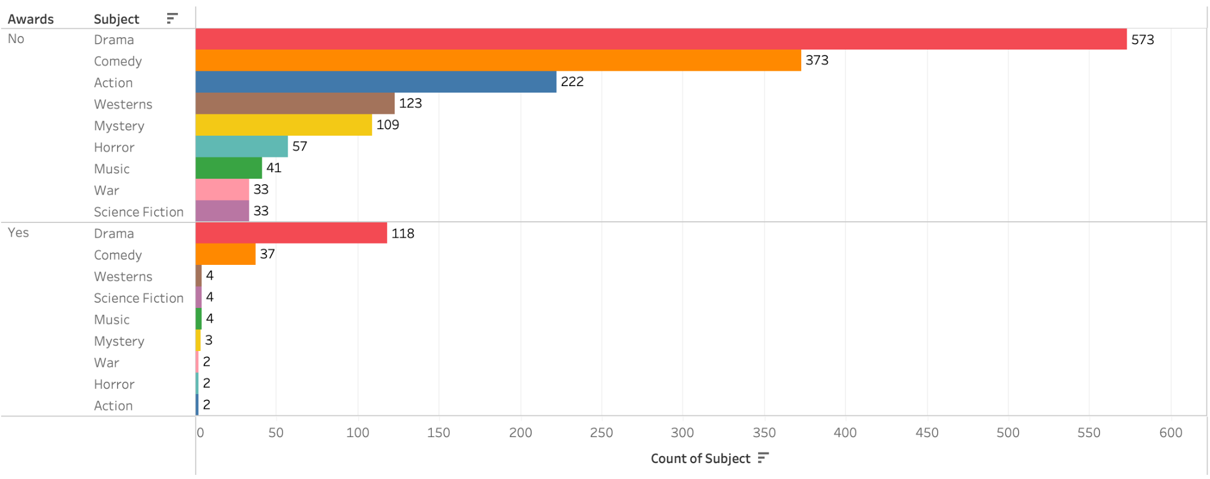
Awards won by Each Genre
Notes:
Nizar
Action 1st popular last awards winner
Drama & comedy followed by western top awards movies

Slide 9
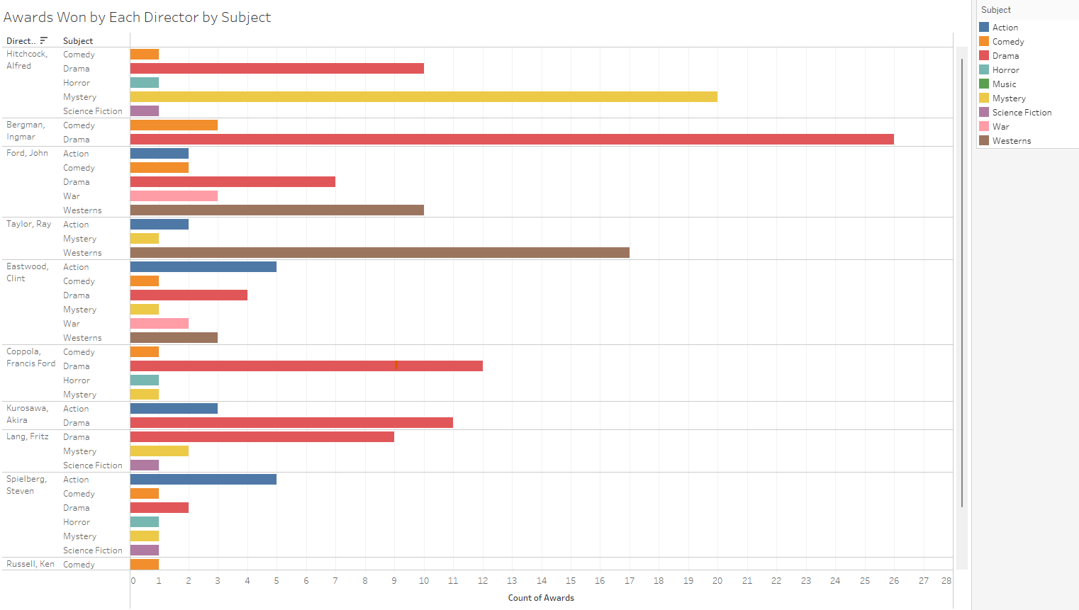
Awards Won by the Top 10 Directors by Subject
Notes:
Nizar
Talk about movie type push us to talk about the directors

Slide 10
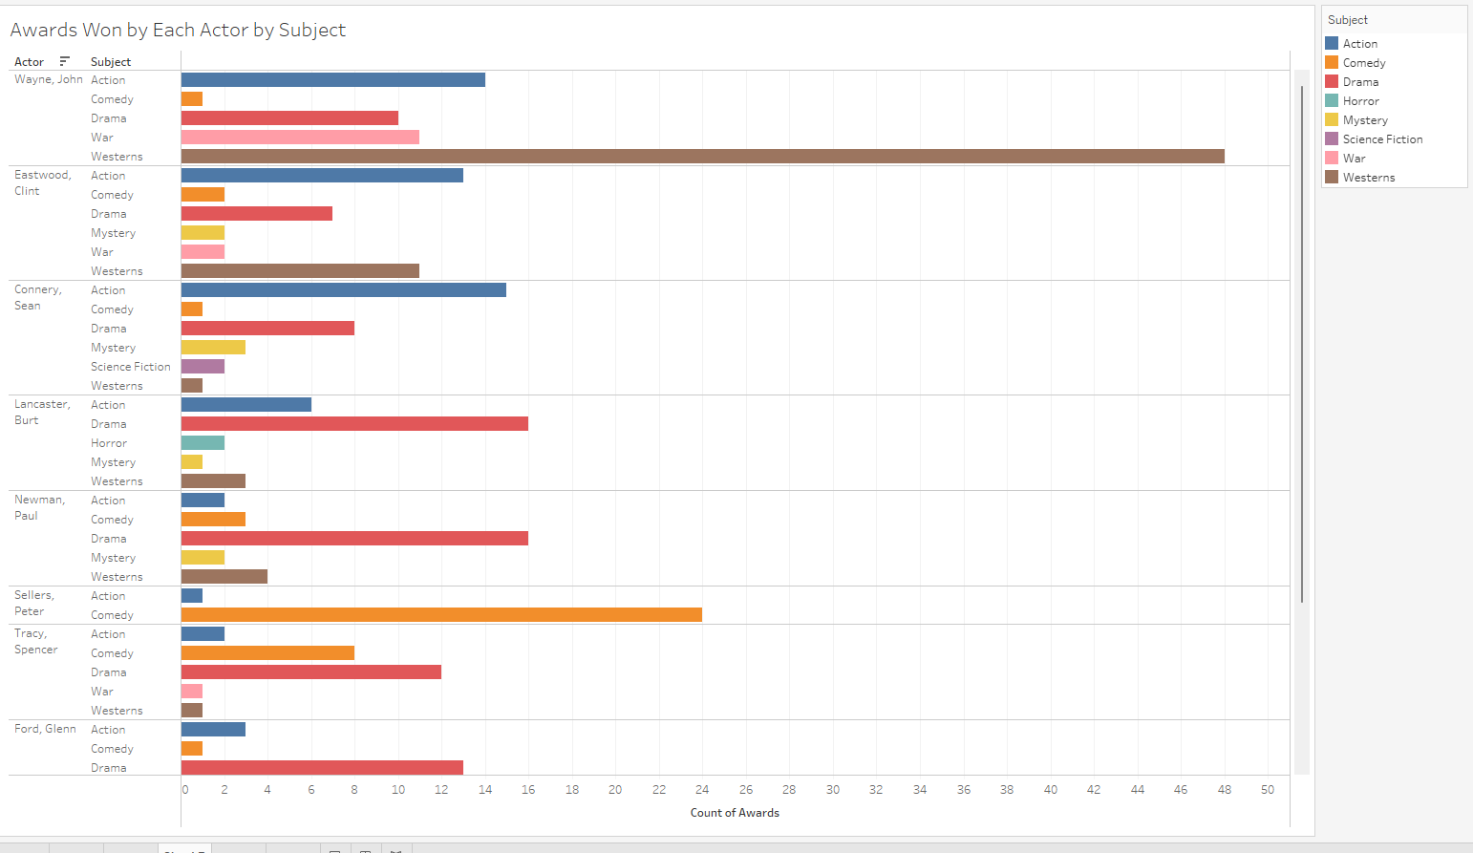
Awards Won by the Top 10 Actors by Subject
Notes:
Dagim
-These are the top 10 actors by awards won and which awards they won by genre
-Very few comedy awards besides Sellers and Spencer
-Mostly physically demanding roles like action, war, and westerns,

Slide 11
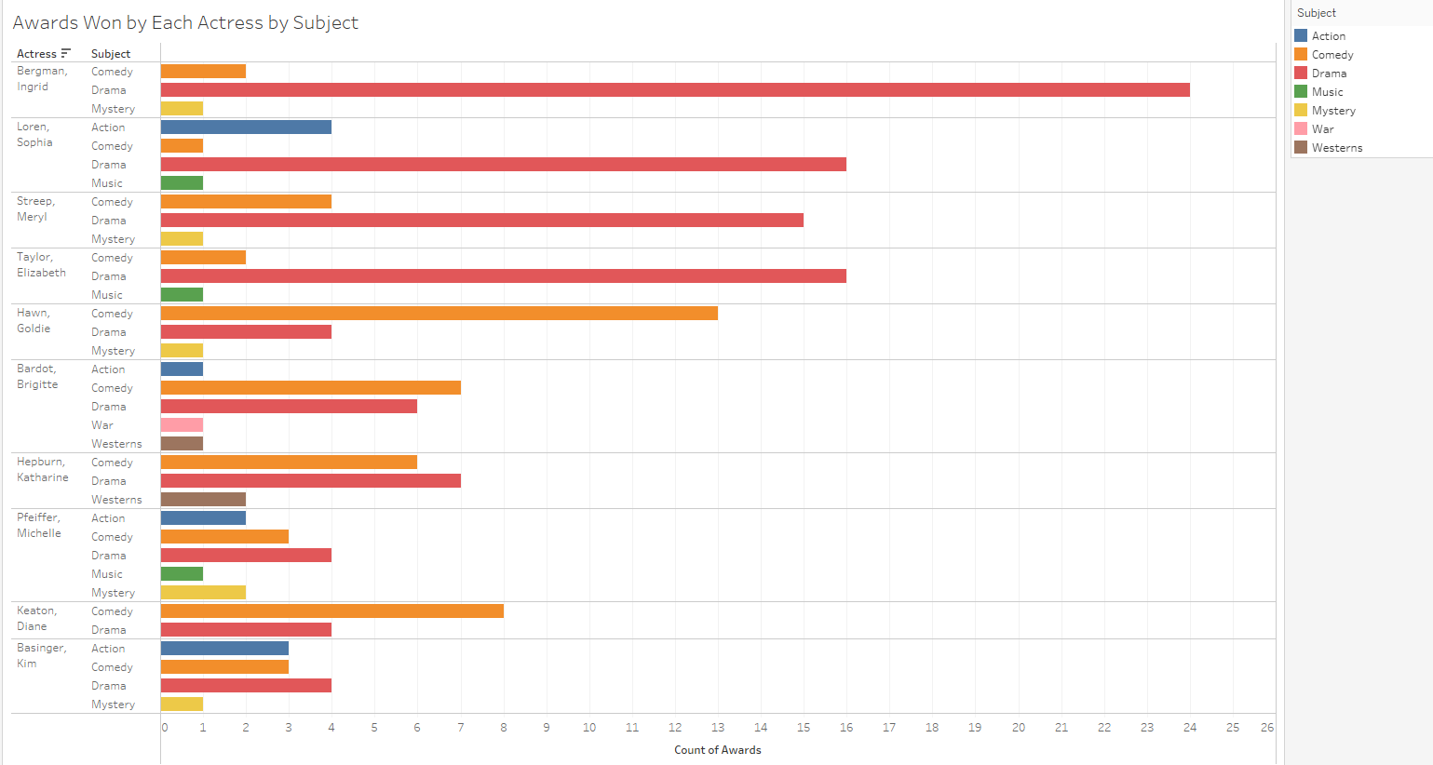
Awards Won by the Top 10 Actresses by Subject
Notes:
Dagim
-mainly won for drama and comedy
-lack in diversity in roles for actresses long time ago (Bergman, Taylor, Hawn, Hepburn)
-more diverse awards for more relatively recent actresses (Pfeiffer, Basinger)

Slide 12
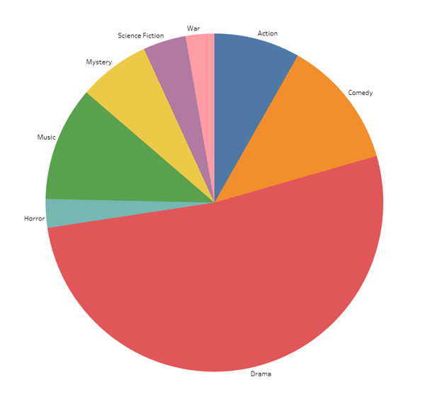
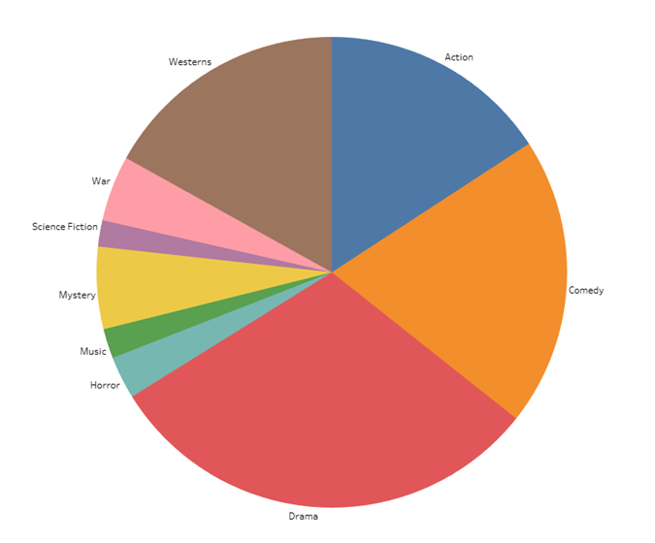
Difference in Leading Roles by Subject for Actors and Actresses
Leading Actresses
Leading Actors
Notes:
Alex
Discuss how actresses have leaned more to drama
Discuss how according to the data actresses are not in western movies
Discuss the gender issues within other genres

Slide 13
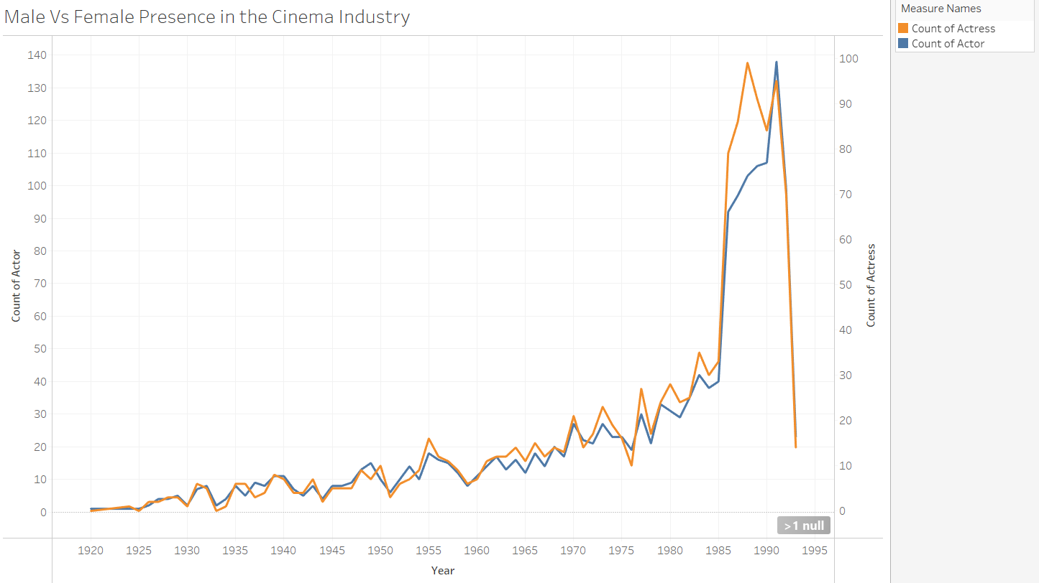
Male vs Female Presence in the Cinema Industry over Time
Notes:
Alex
A massive rise in both genders around 1985
Talk about how both of the lines have different y-axises
Still not a perfect 50% but getting better
Discuss how times look like they are changing going forward

Slide 14
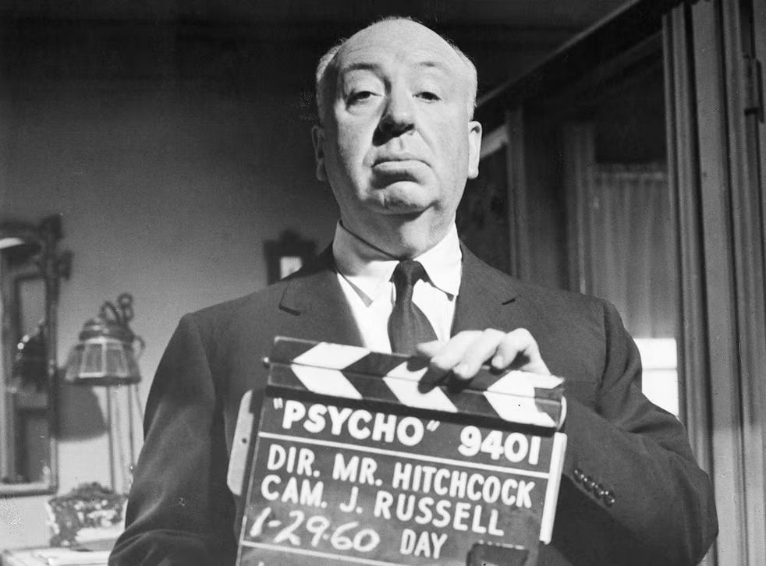
Conclusion
Drama and Comedy have been the top 2 most released genre over time.
There has been a huge spike in movies from 1985 to 1991.
Most Awards Movies were won in Drama, Comedy and Western Movies
Action seems to lead the popularity line followed by Comedy & Drama
Notes:
Dagim:Thank you for taking the time to explore the rich and diverse history of cinema with us. It has been a pleasure to delve into the different genres, directors, actors, and cultural impact that movies have had throughout the years.
Manjinder: It will be exciting to see how the film industry evolves and adapts to new technologies and audience demands.
Nizar: But no matter what changes may come, the magic of movies and their ability to captivate and inspire us will always remain a powerful force.
Alex: Thank you again for joining us on this journey, and I hope you have gained a greater appreciation and understanding of the world of cinema.

Slide 15
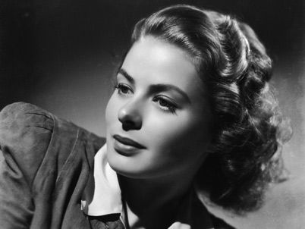
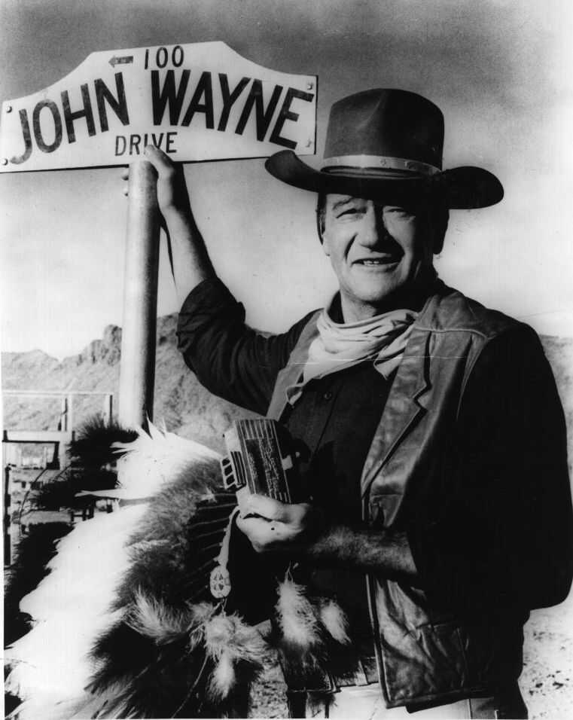
Conclusion
Actors have historically won awards for physical roles
Actresses historically have not been awarded for their range than actors
Actresses are more drawn to drama movies, however, times are changing
Actors have had more diverse roles over the years
Notes:
Dagim: Thank you for taking the time to explore the rich and diverse history of cinema with us. It has been a pleasure to delve into the different genres, directors, actors, and cultural impact that movies have had throughout the years.
Manjinder: It will be exciting to see how the film industry evolves and adapts to new technologies and audience demands
Nizar :But no matter what changes may come, the magic of movies and their ability to captivate and inspire us will always remain a powerful force.
Thank you again for joining us on this journey, and I hope you have gained a greater appreciation and understanding of the world of cinema.

